Slide 1
Mailing from Rails
The Gmail Route

Slide 2
Reference
https://guides.rubyonrails.org/action_mailer_basics.html

Slide 3
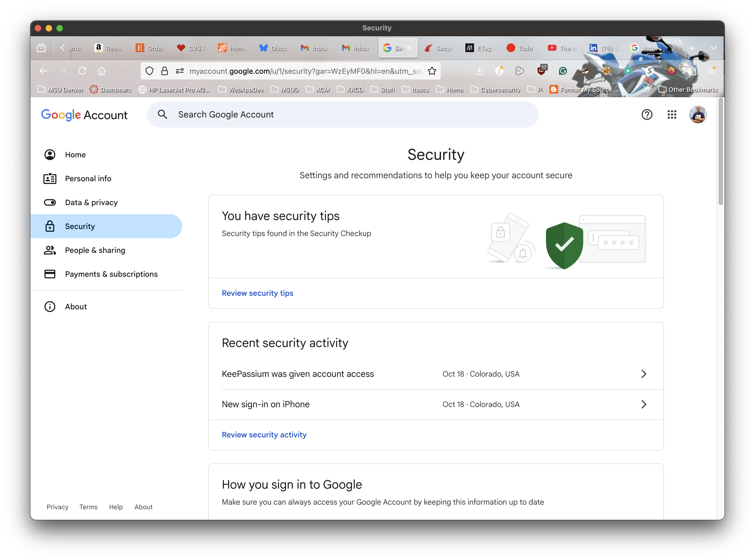
https://myaccount.google.com/security

Slide 4
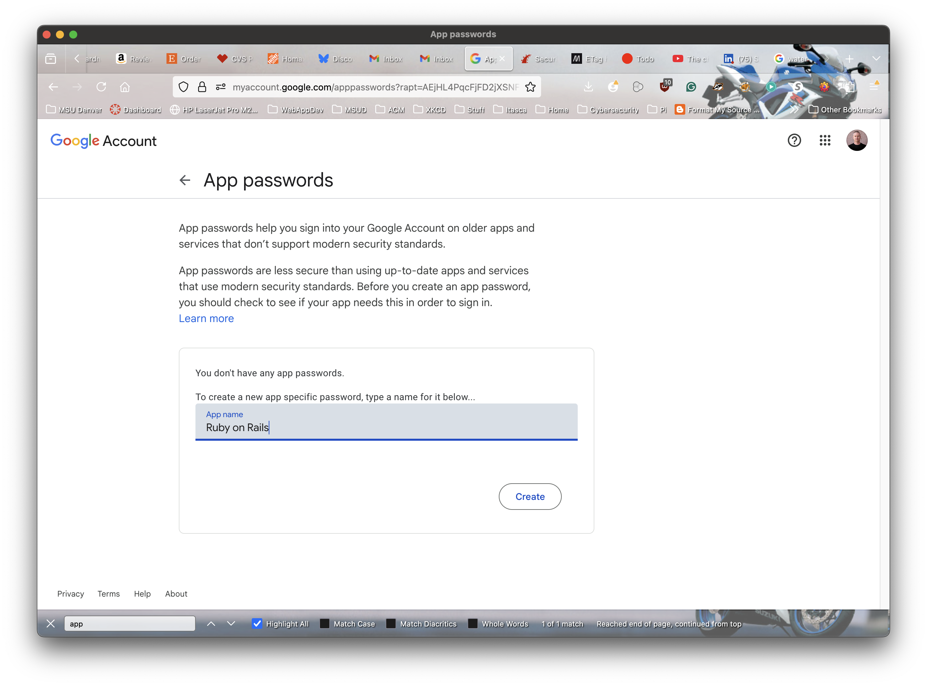
https://myaccount.google.com/apppasswords

Slide 5
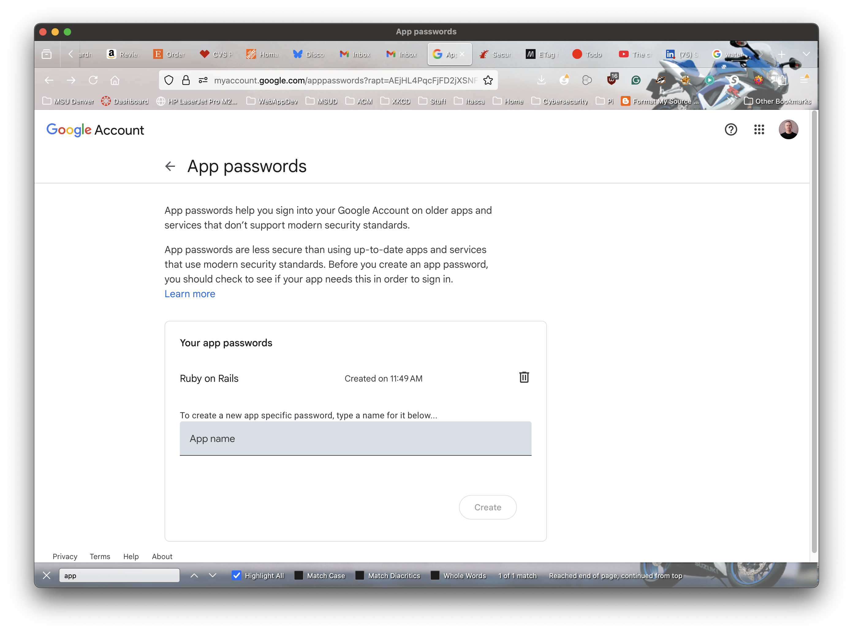
Result

Slide 6
$ git add .
$ git commit -am 'Initial’
$ rails g mailer User welcome_email
$ rails generate scaffold User name email

Slide 7
config/environments/development.rb
# Care if the mailer can't send.
config.action_mailer.raise_delivery_errors = true
config.action_mailer.delivery_method = :smtp
config.action_mailer.smtp_settings = {
address: "smtp.gmail.com",
port: 587,
authentication: "plain",
enable_starttls_auto: true,
user_name: "drsjb80gv@gmail.com",
password: "nope nope nope nope",
domain: "smtp.gmail.com"
}

Slide 8
app/mailers/user_mailer.rb
class UserMailer < ApplicationMailer
default from: "drsjb80gv@gmail.com"
def welcome_email
@user = params[:user]
@url = "http://example.com/login"
mail(to: @user.email, subject: "Welcome to My Awesome Site")
end
end

Slide 9
Testing
my-mailer2(dev)> User.load_schema
my-mailer2(dev)> user = User.new(id: 1, name: "Steve",
email: "beatys@msudenver.edu",
created_at: Time.now, updated_at: Time.now)
my-mailer2(dev)> user.save!
my-mailer2(dev)> user=User.find(1)
my-mailer2(dev)> MailUserMailer.with(user: user).
welcome_email.deliver_later

Slide 10
Testing
$ rails console
my-mailer(dev)> UserMailer.with(user: "beatys@msudenver.edu").welcome_email.deliver_later
Enqueued ActionMailer::MailDeliveryJob (Job ID: cfb16828-1ce9-4999-9ede-66e9e18d8811) to Async(default) with arguments: "UserMailer", "welcome_email", "deliver_now", {:params=>{:user=>"beatys@msudenver.edu"}, :args=>[]}
↳ (my-mailer):1:in `<main>'
=>
#<ActionMailer::MailDeliveryJob:0x0000000125b534e0
@_halted_callback_hook_called=nil,
@arguments=
["UserMailer",
"welcome_email",
"deliver_now",
{:params=>{:user=>"beatys@msudenver.edu"}, :args=>[]}],
[…]

